Slide 1
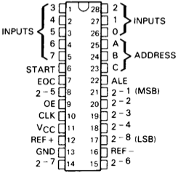
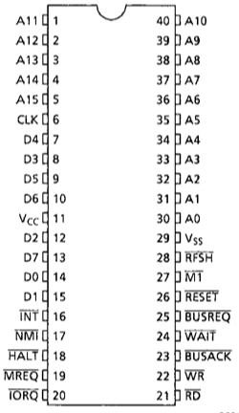
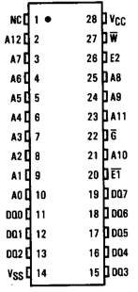
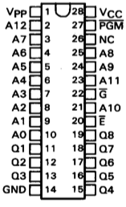
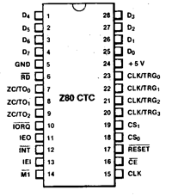
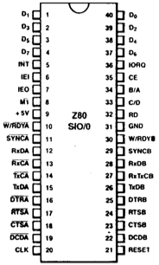
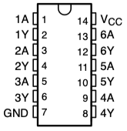
Not connected
Not connected
Not connected
Not connected
Not connected
Not connected
Tied high
Tied high

Slide 2
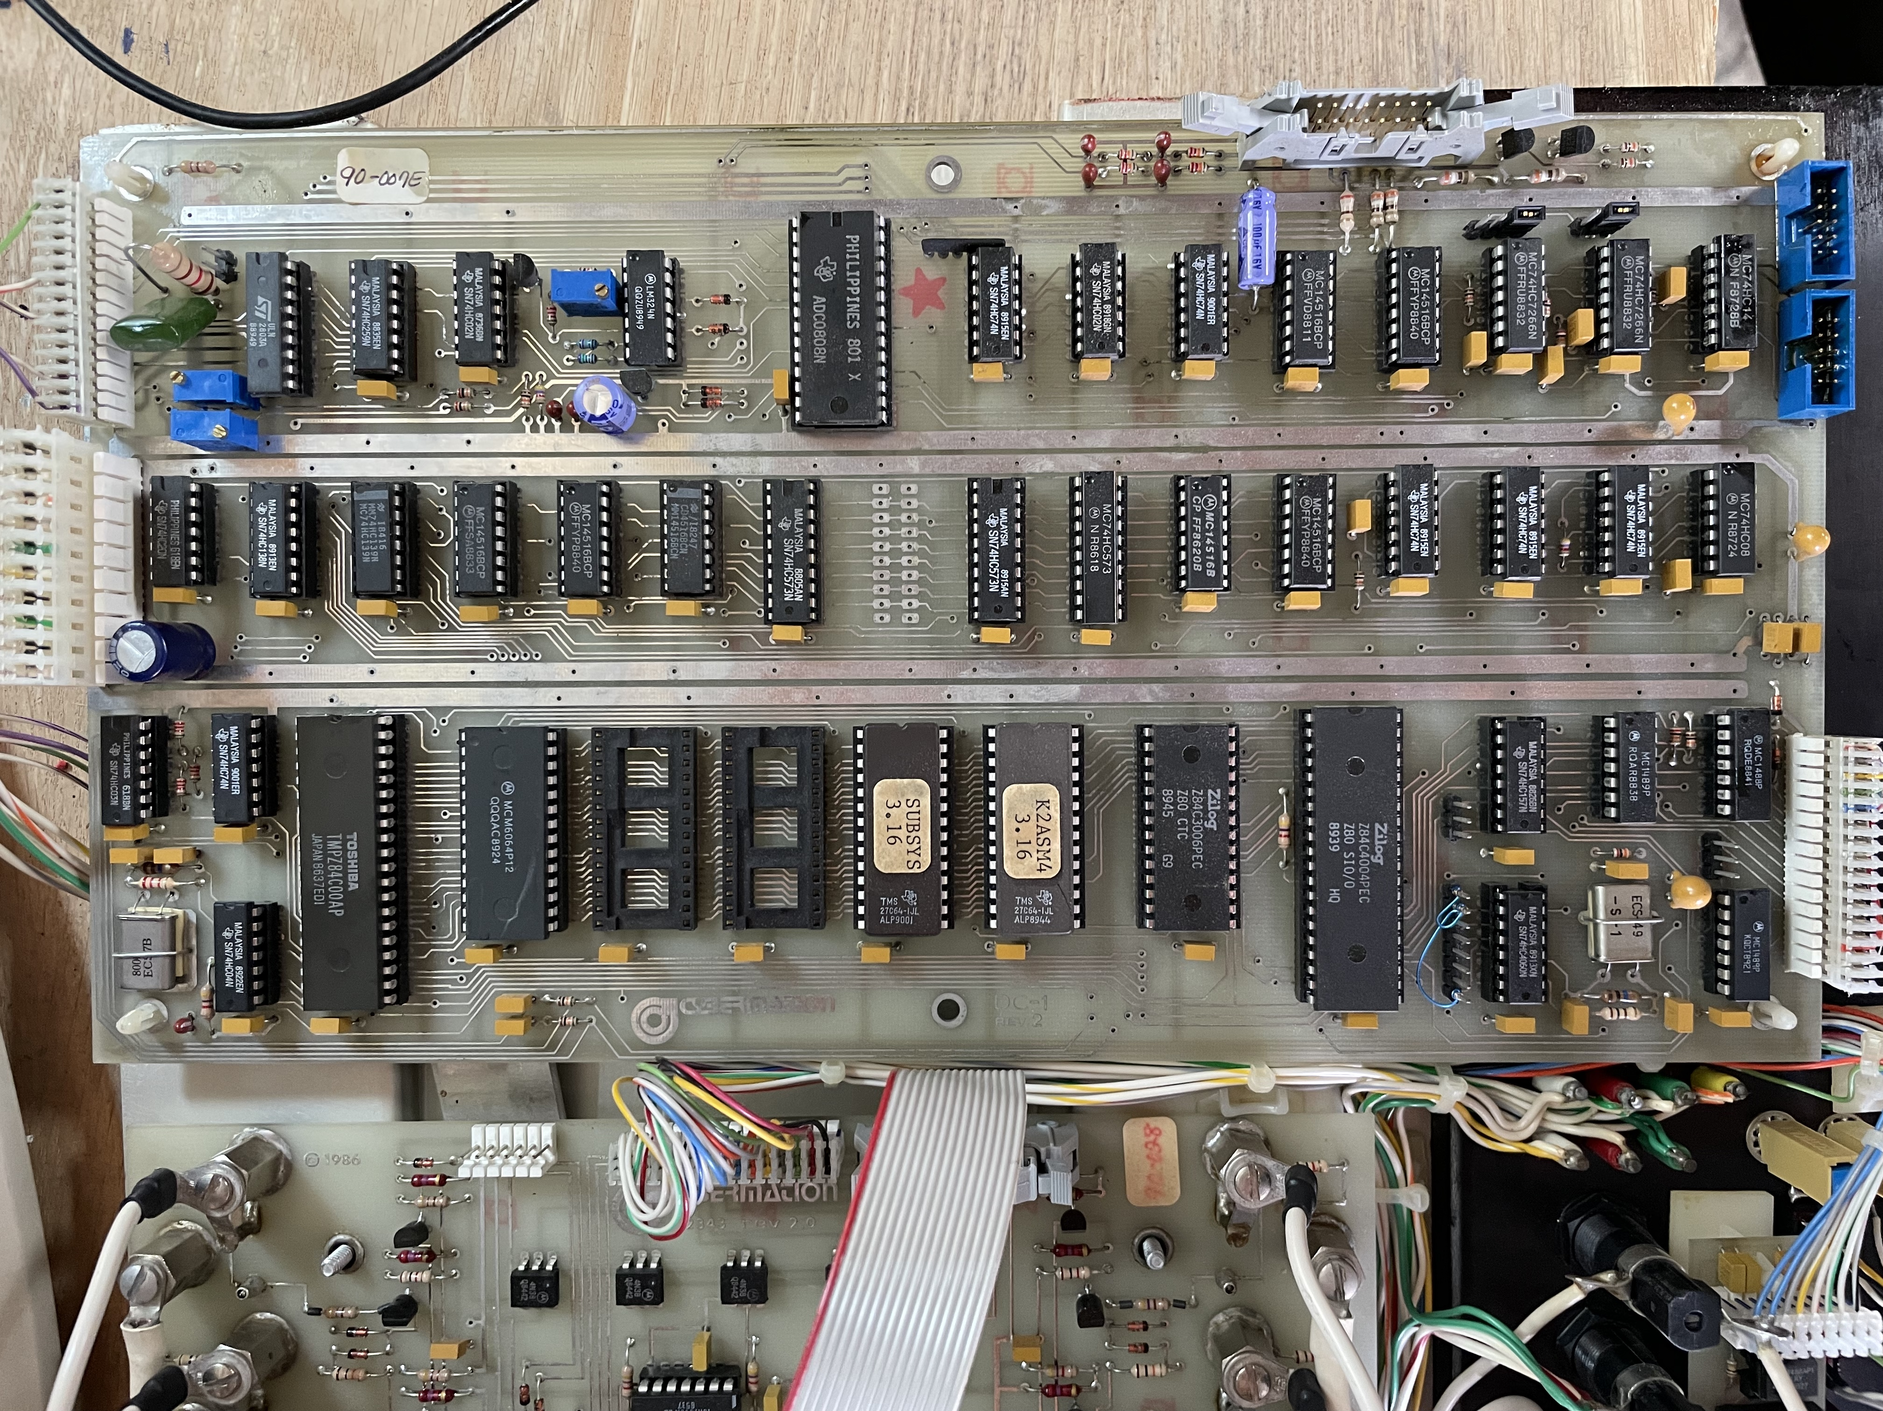
P3
P4
P2
10
11
12
13
1
2
3
4
5
6
7
8
9
P5
P1
14
15
16
17
18
19
20
21
22
23
24
25
26
27
28
29
30
38
40
41
33
34
35
36
37
P6
32
31
39
42

